Slide 1
Travel Nevada Research Resources
Integrated Marketing Effectiveness Study (formerly Ad Marketing Effectiveness Study)
What it measures: Awareness of Nevada’s advertising efforts, intent to travel to state, perceptions of Nevada. Overlap questions include length of stay, trip spend and trips per year, which are also measured through other vendors and are cross referenced for consistency.
Key takeaways/what we look at: Differences between first time/returning visitors; those aware/unaware of advertising; perception changes.
How it is applied: Consideration during media buy/recommendation process; creative direction
What can be improved: Looking at revisions to better align with applicable audience segmentation; framing focused around perception change that we may be able to impact.
Domestic Visitor Study
What it measures: Purpose of trip; trip expenditures; demographics. This study is fielded to actual visitors to the state only.
Key takeaways/what we look at: Economic Impact Study’s Visitor Spending Model uses data from this study. Useful to address questions on travel intent and spend (from press or legislature).
How it is applied: This isn’t necessarily applied but used to better understand travel to the state.
What can be improved: Rather than looking at numbers, data could be better segmented.
Economic Impact Study:
What it measures: Annual aggregate report showing visitor spending, GDP, and employment/income information of visitors at the state level. County level information is publicly available for partners to interactively toggle.
Key takeaways/what we look at: The state of the tourism industry in Nevada. Growth metrics are a focus.
How it is applied: Mostly used in public relations and legislative efforts, as well as being provided to partners for their needs.
What can be improved: N/A
Research Item | Key Metrics/Indicators |  |  | Source
IME Study | Awareness | Travel Intent | Destination Perception | The OmniTrak Group
Domestic Visitor Study | Purpose of Trip | Trip Expenditures | Demographics | The OmniTrak Group
Economic Impact Study | Visitor Generated GDP | Visitor Spending | Employment/Income | Tourism Economics
Resident Sentiment Study | State Tourism Perceptions | Local Tourism Perceptions | Tourism Impact on Family | The OmniTrak Group
Discover The Facts | Room Tax Collections | Visitor Volume | Room Nights Occupied | Multiple Sources
Website Usability Study | Website Strengths | Website Opportunities | Website Recommendations | Destination Analysts
Ad Evaluation Study | Ad Reaction | Interest Change | Ad-Inspired Actions | Destination Analysts

Slide 2
Travel Nevada Research Resources Cont.
Resident Sentiment Study
What it measures: Perceptions of tourism impact at the state, community, and personal level for Nevada residents.
Key takeaways/what we look at: First-time study to baseline how tourism is perceived as an industry for Nevada residents.
How it is applied: Would like to take the results to level set for destination development strategy and for in-state marketing efforts. Initial results show this is a place where we can really move the needle.
What can be improved: N/A
Discover the Facts
What it measures: Quarterly report on room nights and occupancy, room tax collections, airport data and visitor volume among other important measurement indicators as reported to us by various entities throughout the state.
Key takeaways/what we look at: Growth and overall health of the tourism industry throughout the state.
How it is applied: Though not directly applied, it is a key indicator of the pulse of the state’s tourism industry. Any negative trends would be addressed in various capacities in the department.
What can be improved: N/A
Website Usability Study
What it measures: Qualitative and quantitative study looking at how visitors use the website, providing insights into ease of use, how they navigate, and site expectations.
Key takeaways/what we look at: In addition to monthly CRO activity through the year, this study helps indicate how design changes, improvements, and suggestions are received by the general visitor.
How it is applied: Takeaways have fostered continued improvements on TravelNevada.com.
What can be improved: Quantitative refinements have been a challenge due to the robust size of and variety of content types on the website. Consistent and continued CRO tests each month can help alleviate some of the heavy lifting.
Ad Evaluation Study (formerly known as Ad Copy Testing)
What it measures: Gauges reactions to creative executions including general feeling, change in interest, and inspired actions.
Key takeaways/what we look at: Generally, a stop-gap in ensuring the creative agency’s pre-concept research has translated well into execution.
How it is applied: Can re-adjust creative development strategy based on results.
What can be improved: Due to fiscal year restrictions, the study comes after concepting and execution has taken place. Would like to get concepts, then perform the study, then execute in the future.

Slide 3
Travel Nevada Integrating Marketing Effectiveness FY 2019
Exposure to Travel Nevada’s FY 2019 Integrated Marketing Campaign (IMC) had a net positive impact on the target audience. There was a +8 percentage point increase among those considering Nevada for their next vacation between the IMC aware and unaware audience, as well as a +11 point increase in those planning to visit in the next 12 months. Those who were aware of Travel Nevada’s IMC also took more trips to Nevada (+0.4 trips) and spent significantly more (+$1,200) on average per household per year. The campaign also helped shift perceptions of the state. Notably, there was a +9 point increase in those who said they would post about Nevada on social media, and a +8 point increase in those who said Nevada is a place where they are inspired to try new things and who stated Nevada is their preferred vacation destination for those who were aware of the campaign compared to those that were not aware. Further, there was a net positive increase on each attribute tested for first time visitors to the state and all but 2 attributes for those who have never visited overnight.
IMC Impact on Destination Attributes – Aware vs Unaware Difference | Total Audience | First Time Visitors | Never Visited Overnight
I would post about traveling here on my social media | +9 pts | +9 pts | +13 pts
A place where I’m inspired to try new things | +8 pts | +10 pts | +10 pts
Is my preferred destination for overnight, leisure vacations | +8 pts | +10 pts | -
Great place for shopping | +7 pts | +10 pts | +5 pts
Offers a variety of special events/festivals | +5 pts | +8 pts | +9 pts
The landscape is clean and untouched | +4 pts | +6 pts | -1 pts
A place I would recommend to my friends | +4 pts | +8 pts | +9 pts
Is a vacation destination for someone like me | +3 pts | +8 pts | +15 pts
Offers winter sports/activities | +3 pts | +3 pts | +7 pts
Offers good value for the money | +3 pts | +7 pts | +10 pts
Is a friendly, welcoming place | +3 pts | +6 pts | +12 pts
Has interesting rural/small towns to visit | +3 pts | +6 pts | +4 pts
A destination that is truly different from other places | +3 pts | +6 pts | +3 pts
It is a good place for family and children | +2 pts | +3 pts | +5 pts
Is a good place to explore/sight-see by car | +2 pts | +5 pts | +0 pts
It is a beautiful scenic place | +2 pts | +4 pts | +6 pts
Is a place where I can relax | +2 pts | +3 pts | +1 pts
Has lots of things to see and do | +1 pts | +7 pts | +8 pts
Offers summer sports/activities | +1 pts | +4 pts | -2 pts
Is easily accessible (time, transportation, etc.) | +1 pts | +6 pts | +9 pts
Is a place where I receive good service while on vacation | +1 pts | +4 pts | +11 pts
Is a place to experience western history and culture | +1 pts | +3 pts | -1 pts
Has a variety of outdoor terrain for many adventure activities | 0 pts | +4 pts | +15 pts
Costs of hotels and meals are reasonable | -1 pts | +6 pts | +3 pts
Offers a variety of entertainment options | -1 pts | +8 pts | +14 pts
Offers a variety of dining options | -2 pts | +6 pts | +7 pts
Can gamble there | -8 pts | +3 pts | +4 pts
Target Audience Definition: age 21+, travels at least one per year overnight for leisure, lives in Los Angeles, San Francisco, Sacramento, San Diego, Las Vegas, Reno, Phoenix, Salt Lake City, Boise, Portland, or Dallas

Slide 4
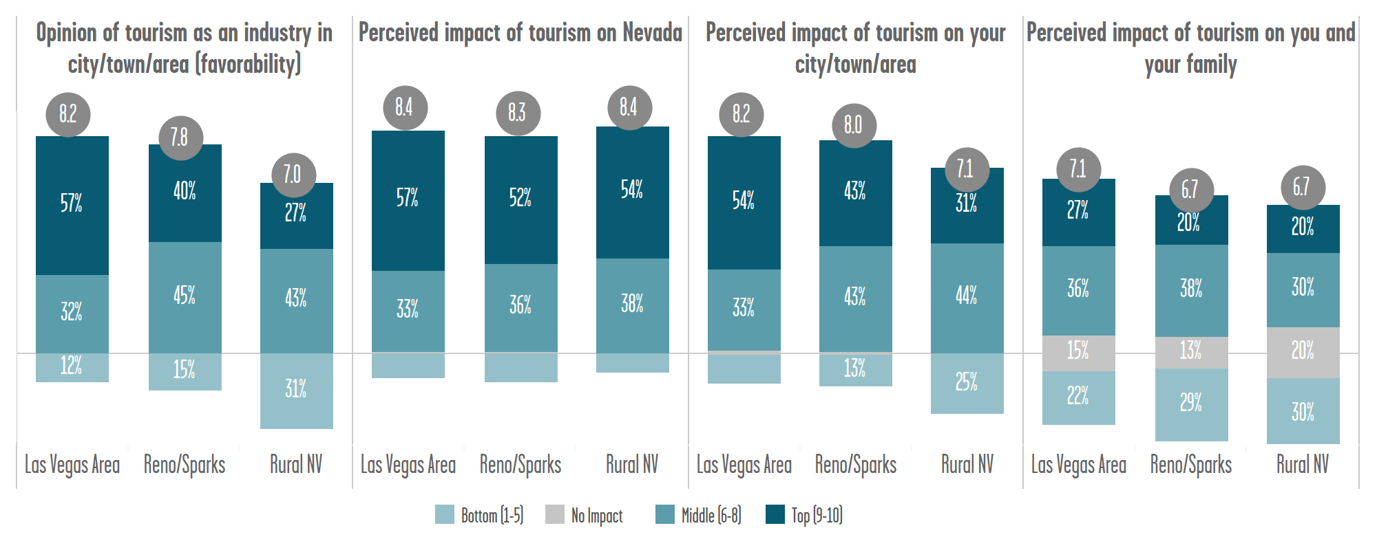
Nevada Tourism Resident Sentiment Study
Understanding regional variations in resident sentiment towards tourism is vital to strategic development for addressing various audiences. Within Nevada, as one would expect, residents of the Las Vegas area had the most favorable opinion of tourism in their area, the perceived impact of tourism in their area, and perceived impact of tourism on themselves and their families. Residents of Reno/Sparks and rural Nevada generally have a higher opinion of tourism’s impact on the state as a whole than their local areas, though Reno/Sparks generally has a higher sentiment across all categories than does rural Nevada.
Residents of different areas within the state also have differing views regarding specific impacts tourism has on their local area. Again, regional differences in perceptions are generally, though not universally, more pronounced between Nevada’s two largest tourism areas (Las Vegas, Reno/Sparks) and its collective rural regions. The starkest differences in rural and urban residents' perceptions include tourism creating local jobs that pay well and have advancement opportunities, enhancing residents’ quality of life, and providing amenities for residents such as shopping, restaurants and entertainment.
Resident Perceptions of Local Tourism Impacts
Average agreement for each statement (scale 1-10) | Las Vegas Area | Reno/Sparks | Rural NV
Creates many jobs for residents | 8.2 | 7.9 | 6.5
Provides well paying jobs | 7.4 | 6.2 | 5.6
Creates jobs that have advancement opportunities | 7.6 | 6.9 | 5.8
Generates taxes that get reinvested in local community | 7.7 | 7.6 | 7.1
Provides shopping, restaurants, and entertainment for residents | 8.3 | 8.1 | 6.5
Sponsors festivals, activities, & sports events for residents/visitors | 8.1 | 8.6 | 7.4
Is an industry that enhances residents’ quality of life | 7.2 | 6.9 | 5.9
Helps to preserve the area’s culture | 7.0 | 7.0 | 6.6
Helps sustain the area’s natural resources, parks and cultural sites | 7.0 | 6.8 | 6.6
Tourism has brought more benefits to local quality of life than problems | 6.8 | 6.8 | 6.1
The area is being run for tourists at the expense of local people | 5.8 | 4.9 | 4.2
Tourism in the area increases traffic problems | 7.9 | 7.5 | 6.9
The area’s economy is too dependent on tourism | 6.9 | 5.6 | 5.2
Tourism increases the likelihood that businesses will relocate to the area | 7.3 | 7.1 | 6.1
Tourism is consistent with community values in the area | 6.2 | 6.6 | 6.0
Tourism presents the area’s culture in an authentic manner | 6.3 | 6.3 | 6.0
Tourism make me feel proud because people travel to see my area’s features | 6.7 | 6.8 | 6.3
Tourism should be actively encouraged in the area | 7.3 | 7.5 | 7.2
More State funds should be spent to promote tourism in the area | 5.4 | 5.7 | 6.2
I feel like I have a voice in the area’s tourism development decisions | 4.0 | 3.8 | 3.7

Slide 5
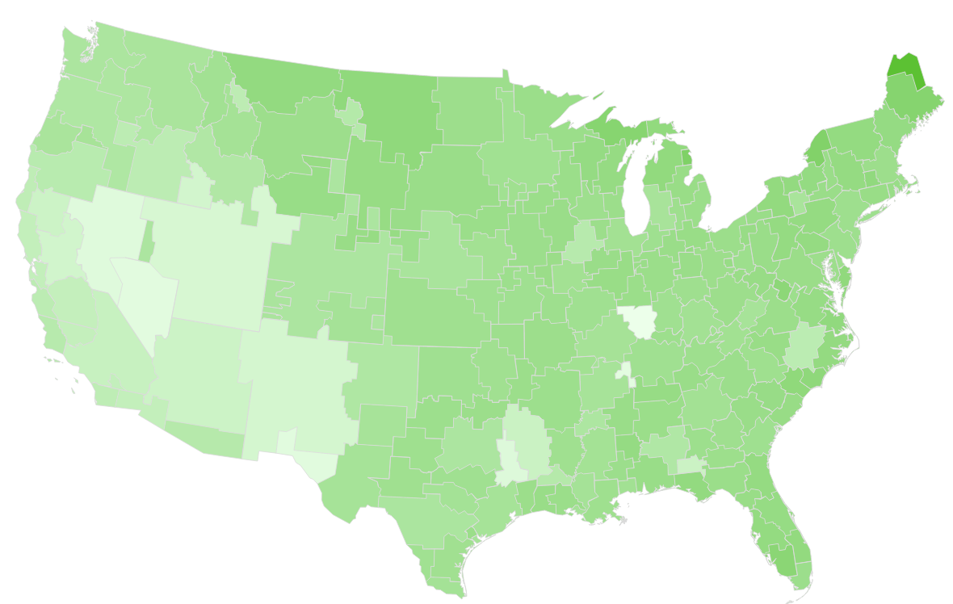
Market Anecdotes
It is important for Travel Nevada to keep a pulse on which markets to focus advertising efforts. Traditionally, Travel Nevada has relied on marketing to major western cities. Though major western cities make up a large percentage of travel to Nevada, it should also be noted that longer haul markets have shown to have higher engagement on the Travel Nevada website than more short haul markets. Markets such as Chicago, New York and Minneapolis have higher engagement on site when compared to markets that generate similar levels of sessions such as San Diego, Phoenix, and Salt Lake City.
Further, these longer haul markets spend more time in the state. Based on data from Arrivalist,, the further a market is from Nevada, the longer the average time in Nevada tends to be. Therefore, there may be an opportunity to take a deeper look at long haul markets that have both a large amount of visitors traveling to the state that also have a high length of stay. It can also be noted that these longer haul markets are likely to be less familiar with Nevada, which results from the IME Study indicate marketing efforts can have a large effect in pushing the needle in terms of destination perceptions.
Average Time in Nevada
Note: Website metrics listed filtered for traffic to site from organic search, paid search, referrals, or direct traffic. This helps to better compare metropolitan areas as traffic coming in via advertising efforts is more heavily skewed to certain metro areas and has a tendency to be less engaged, hurting their overall score.

