Slide 1
Tradeshows & Activations
Domestic & International Trade

Slide 2
Visitor Volume
Source: LVCVA, RSCVA, OmniTrak

Slide 3
Room Tax Collections (State Portion)
Source: Nevada Department of Taxation

Slide 4
Trade Market Segments
Domestic – US travel advisors & Tour Operators ex: Pleasant Holidays, AAA vacations, Southwest Vacations, ALG, etc.
International – International travel advisors & Tour Operators ex: TUI, Qantas Vacations, Holiday World, FTI, Trailfinders, etc.
Receptive – Inbound tour operators and consolidators for domestic & International ex: Hotelbeds, ATI, Bonotel, New World Travel, American Ring etc.
Motorcoach – bus tour operators who service primarily domestic, however they will handle some international clients ex: Contiki, Globus, Cosmos etc.
Local/DMC – domestic operators and international receptives that have a presence in Nevada, such as: JTB, NTA, AlliedTpro, ALG, Bramer Tours, Scenic Tours and Hello Las Vegas

Slide 5
FY 2024 Q1 & 2 Initiatives

Slide 6
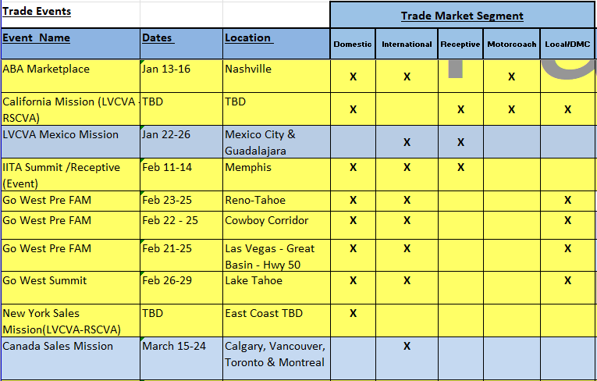
FY 2024 Q3 Initiatives

Slide 7
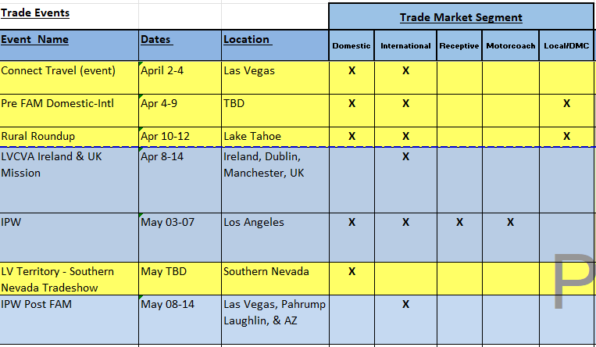
FY 2024 Q4 Initiatives

Slide 8
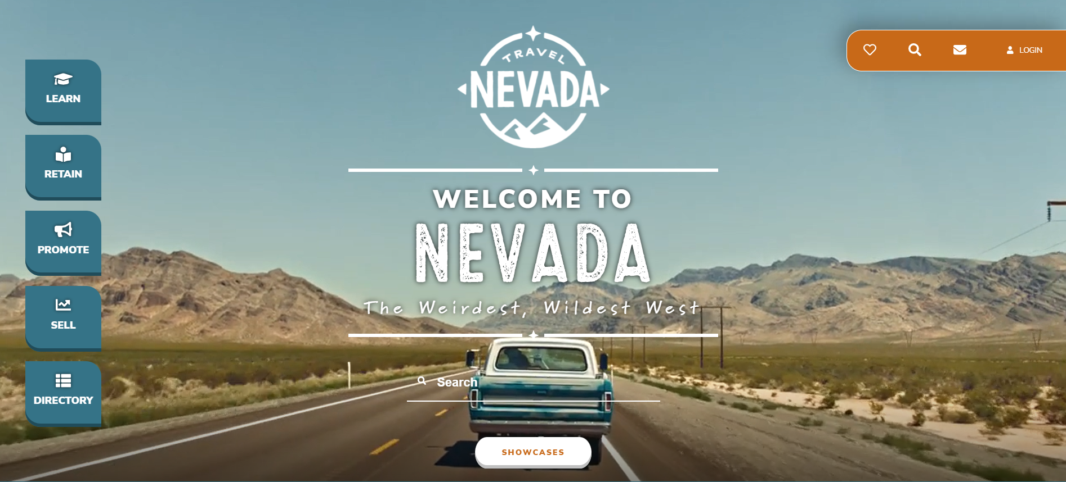
NV Trailblazers
Training platform for tour operators, wholesalers, agents, airlines & receptives

Slide 9
NV Trailblazers
Online & offline training available 24/7
  Total of 1,023 registrants (domestic & international)
  402 completed the certification
Mobile and desktop access
English and Spanish versions
Incentive program
  Quarterly prize drawings
  Qualify for FAMs

