Slide 1
Presentation to the Nevada Commission on Tourism
Mary Beth Sewald, Vice Chairman
Reno Air Racing Association

Slide 2
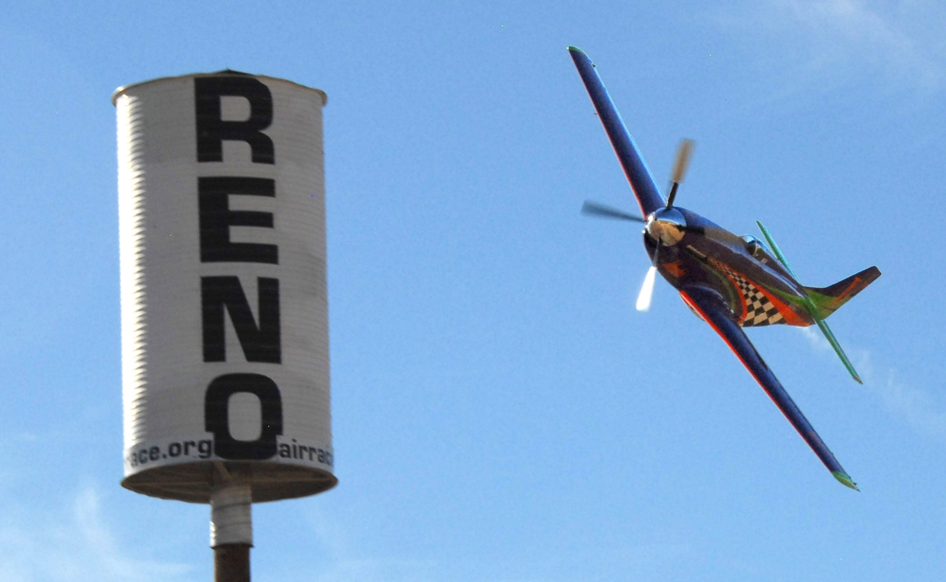
Welcome

Slide 3
Economic Impact Study
“The methodology used in both 2014 and 2016 was not only consistent across years, but has generated reliable data for seven other events in the Reno-Tahoe area since 2013.”
“The design and implementation of the study is based on best survey research practices.”
“Random sampling and neutral survey language are examples of best practices used consistently to produce valid and reliable data across all events participating in the UNR special event project.”*
*Special Event Report: 2016 National Championship Air Races, University of Nevada, Reno Center for Economic Development

Slide 4
2016 Results
Attendance in 2016 was up 11.4% over 2014
Average length of stay: 3.7 days
65.1% of non-locals visited the area only because of NCAR
69.2% of non-local attendees plan to attend NCAR at least six weeks in advance
Hotel lodging accounted for 73.7% of all non-local lodging
29.8% of non-locals traveled to the Air Races via air
Economic Impact: Average total spending for all respondents is $2,224.43

Slide 5
Total Economic Impact
In 2016, The National Championship Air Races had a total economic impact of $91.7 million
In 2014, NCAR had a total economic impact of $66.4 million
$25.3 million increase from 2014

Slide 6
Demographics of Non-Local Attendees
84.6% are between ages 25 and 64
54.3% have a household income of $100,000 or more
95.9% have completed education above the high school level

Slide 7
2016 Economic Impact
Total dollars spent by type for non-locals who visited only because of NCAR
2016 Economic Impact
Lodging | $11.9M
Gaming | $7.7M
Food & Drink | $13.4M
Shopping | $6.9M
Entertainment | $14.6M
Transportation | $24.3M

Slide 8
Job Creation
Direct spending supports 708 full-time jobs for a year
Secondary spending supports 292 full-time jobs for a year
Total employment impact: 1,000 full-time jobs for a year
Direct Impact 708.3
Indirect Impact 158.1
Induced Impact 133.7
Total Impact 1,001.2

Slide 9
Platinum Sponsorship $40,000
(10) Season Reserved Parking
(6) Daily Scheduled Pylon Visits (Fri, Sat, Sun)
Two-page, 4-color Ad Space in the Official Event Program
(10) Thirty-second Public Address Announcements
Space to Display (10) 3’ x 10’ Banners
Logo and Link on Website as a Platinum Sponsor
Logo on Sponsor Board
(3) Messaging Opportunities on Facebook and Twitter
Option for large banner placement in GA area

Slide 10
THANK YOU

