Slide 1
Partner Presentation – TravelNevada.biz Research

Slide 2
Agenda
Run-through of TravelNevada.biz research
Accessing / interpreting the data
Questions (for us and for you)

Slide 3
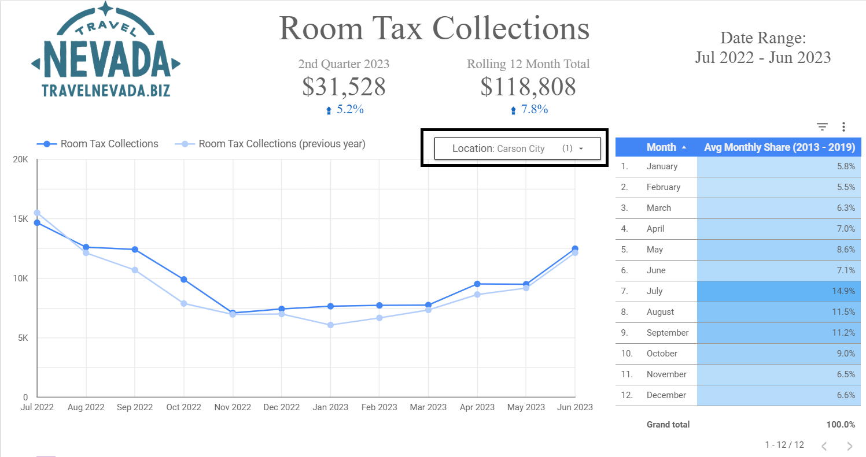
Review
Look at statewide and area-specific data in Discover the Facts Dashboard
Location filter allows for interactivity to display different areas of the state for metrics where we have data

Slide 4
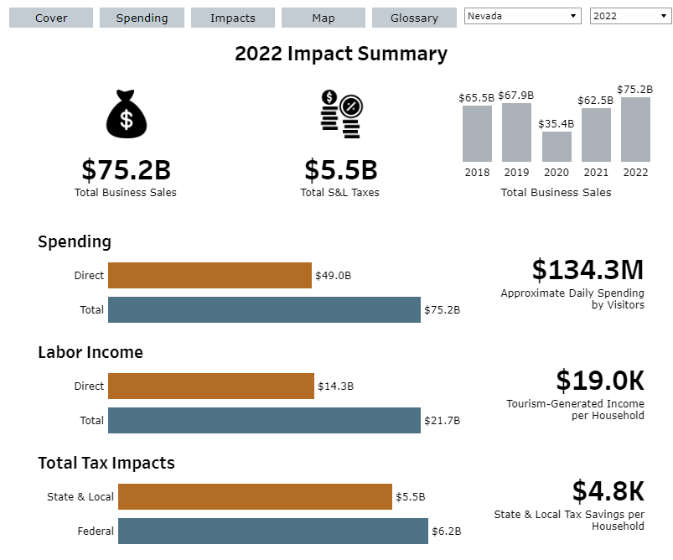
Review
The Economic Impacts Dashboard allows you to interact with data for each county.
“Impacts” tab gives ability to look at economic impacts for metrics such as visitor spending, employment, income and tax generation
Also look at “Total” impacts for more complete picture of economic impact in community. “Direct” impacts represent economic activity generated directly from visitor spending, but “Total” impacts tell the story of indirect and induced impacts as well.

Slide 5
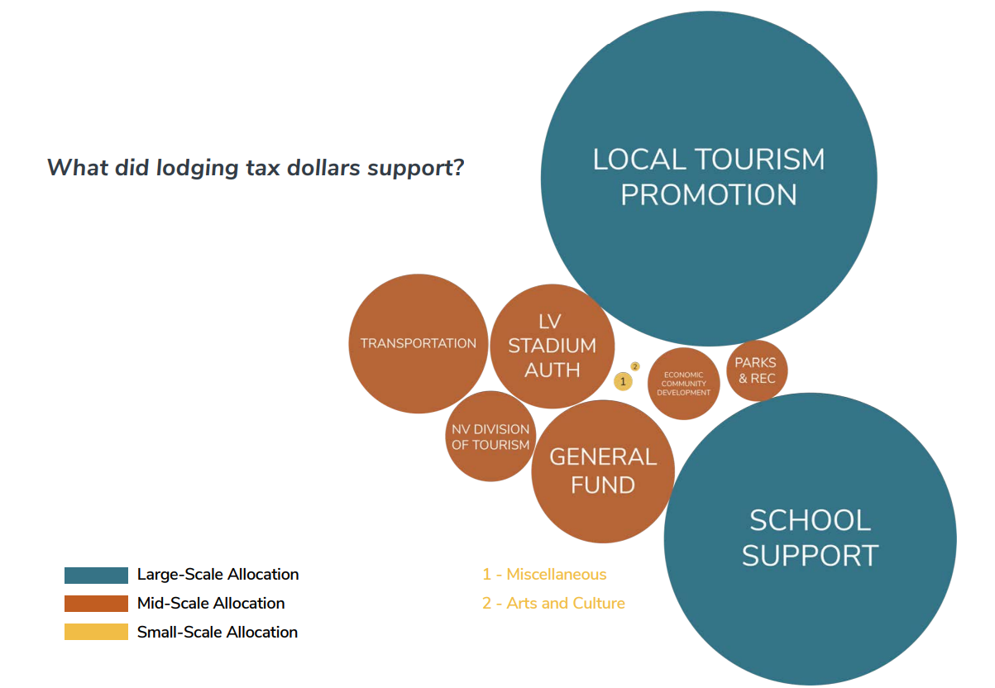
Review
Tourism Ecosystem Report shows how all lodging taxes are allocated across the state
This is used to show decision makers how allocation of the tax directly benefits constituents through things like school support, transportation infrastructure, parks and recreation, etc.
There are examples throughout the report of specific allocations in individual communities

Slide 6
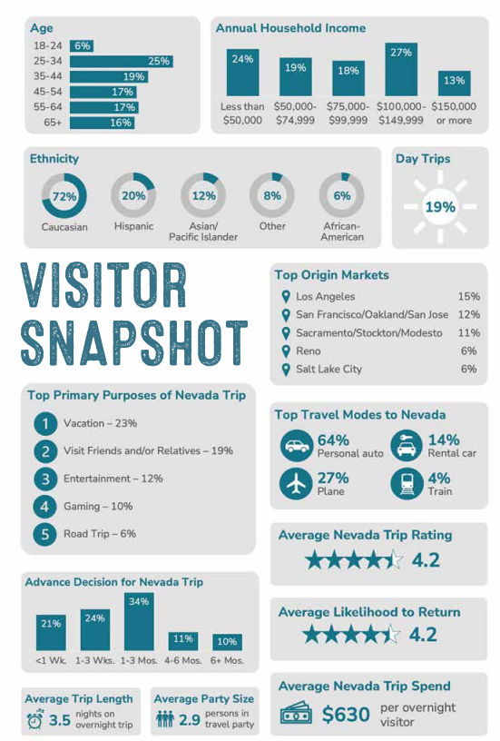
Review
Visitor profiles by territory can give an overview of key visitor related data such as length of trip, spending, demographic breakdowns, etc.
But, be aware that the data is generated on a trip-level. For, example, day trip percentage is the percentage of day trips for their trip to the state of Nevada, not necessarily a trip to the particular territory / area.

Slide 7
Questions
For you:
Are there any particular pieces of research that would be valuable for you to see that we don’t already have?
Examples:
Survey of tourism leaders across the state each quarter to give a pulse check on tourism industry in their area, publish results on travelnevada.biz
Generating a “tourism index” for different parts of the state
Creating a dashboard for economic metrics that have a high correlation with Nevada room demand
Questions for us?

