Slide 1
Interactive Web Mapping for Statewide Recreational Trail Networks
Jasmina Sekanovich, State Recreation Mapping Coordinator

Slide 2
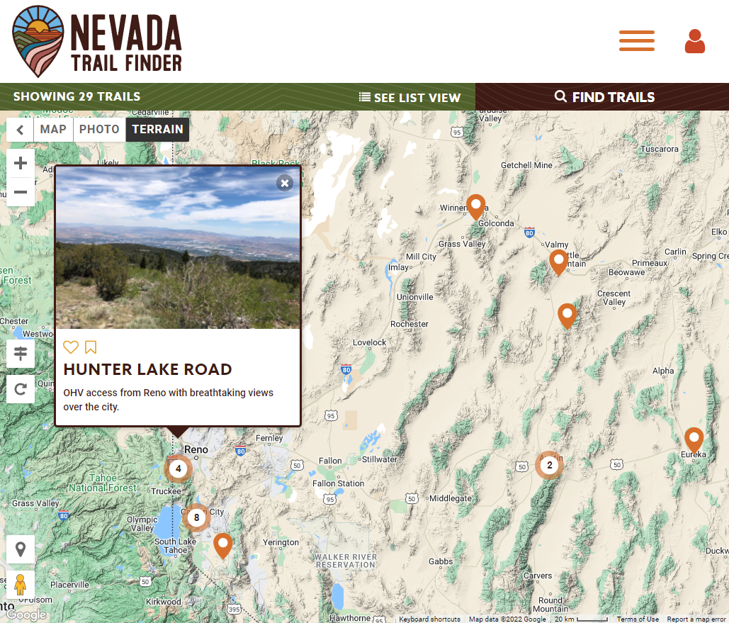
What is the Nevada Trail Finder (NVTF) ?
State sponsored and funded mapping website
Postings Complete with -
Trail Maps
Trailhead Descriptions
Local Campsites and Lodging
Nearest Towns and Cities
Safety Information
Land Manager Contacts
Local Riding and Weather Conditions
Link to Flow Conditions for Waterway Trails
Available Data Downloads -
GPX
KML
Georeferenced PDF maps

Slide 3
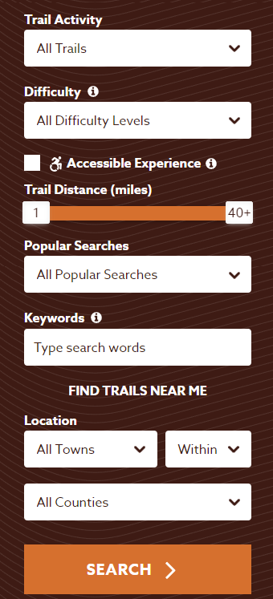
Functionality
Easy to navigate homepage that allows users to select by activity type
Users can create an account
Bookmark Trails
Create a Trail Log
Add Photos
Interactive map that allows users to search by activity type, difficulty, location and length of trails

Slide 4
How this website is unique
Data published on NVTF is verified by landowners or agencies.
BLM
US Forest Service
Cities
Counties
This enables users to avoid trespassing on private property, disturbing protected habitat, and receive updated trail alerts from land managers.

Slide 5
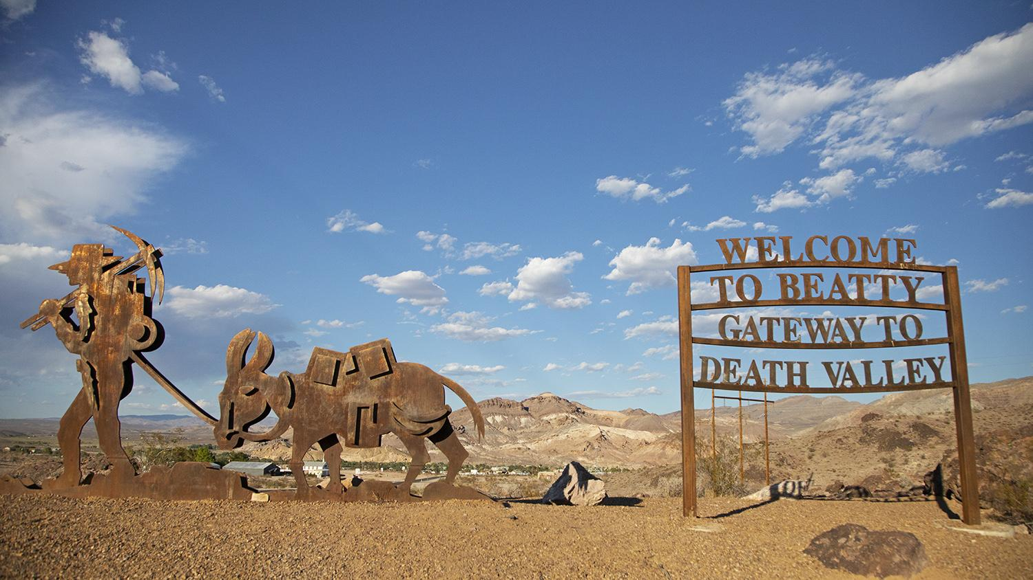
Benefit to your community
Encourage safe travel
Helps visitors and residents alike discover new areas
Increase visibility of local businesses
Promote local events
Tech free on your end and no maintenance needed
An embedded map will increase traffic to your website, as well as ours
Example of embedded map into website: https://www.nvtrailfinder.com/page/index/preview/k/cf67355a3333e6e143439161adc2d82e
Notes:
Helps the community bc you don’t have to find your own GIS team or trails data, we can provide that for you and the platform for display. Helps visitors and residents to plan a safe and fun outdoor adventure and spend money at local businesses. Background is on google maps to users can also see what other nearby restaurants there are. Eventually would like to upgrade to have an events page on NVTF and we could advertise local events. Help us to make your pages the most up to date and accurate, really doing us a favor. Aside from NVTF if there are any other outdoor rec mapping your community needs, we can help support.
Show how to embed the map and trails into website
https://www.nvtrailfinder.com/page/index/preview/k/cf67355a3333e6e143439161adc2d82e

Slide 6
Website traffic
Two ways to see how visitors are using the website:
Google Analytics
Branch CMS Back end of website
Notes:
Very broad sense of who is visiting the website and how visitors are using it
Cannot tell if the person actually went there, only that they viewed the page.

Slide 7
Demo
Nevada Trail Finder

Slide 8
Thank you!
Jasmina Sekanovich - State Recreation Mapping Coordinator
Email: jsekanovich@ohv.nv.gov
Phone: (775)684-2795

