Slide 1
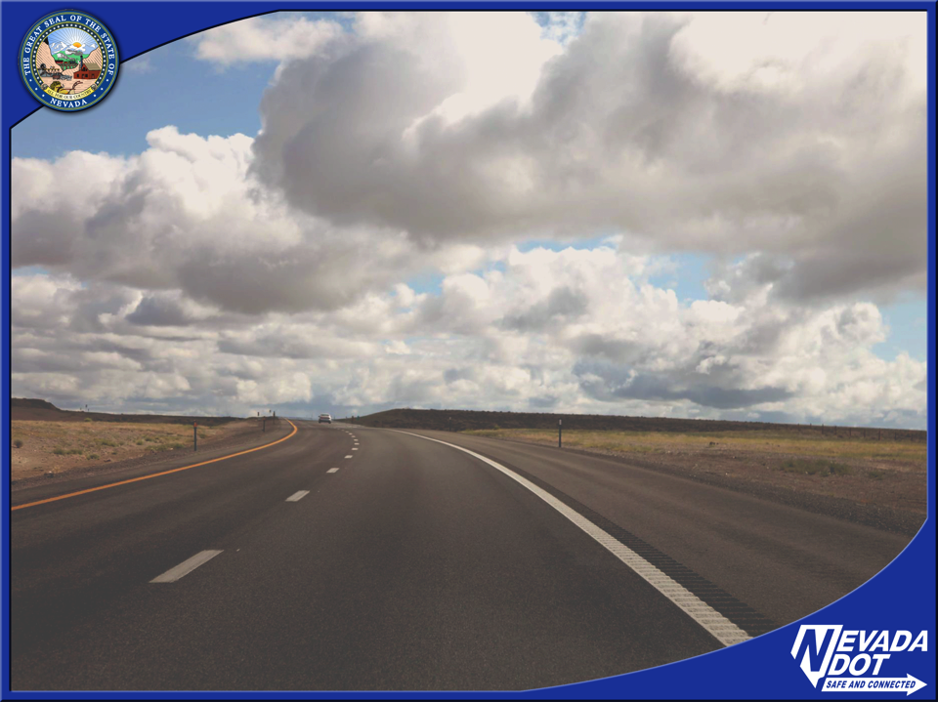
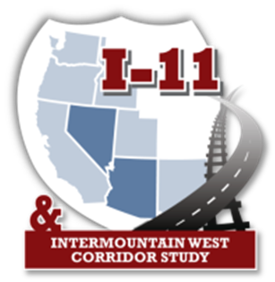
Future Interstate 11
Kevin Verre
Assistant Chief, Multi-Modal & Program Development
Nevada Department of Transportation
Notes:
Good Afternoon,
My name is Kevin Verre with the Nevada Department of transportation.
Today I will give you a brief overview of the Future Interstate II

Slide 2
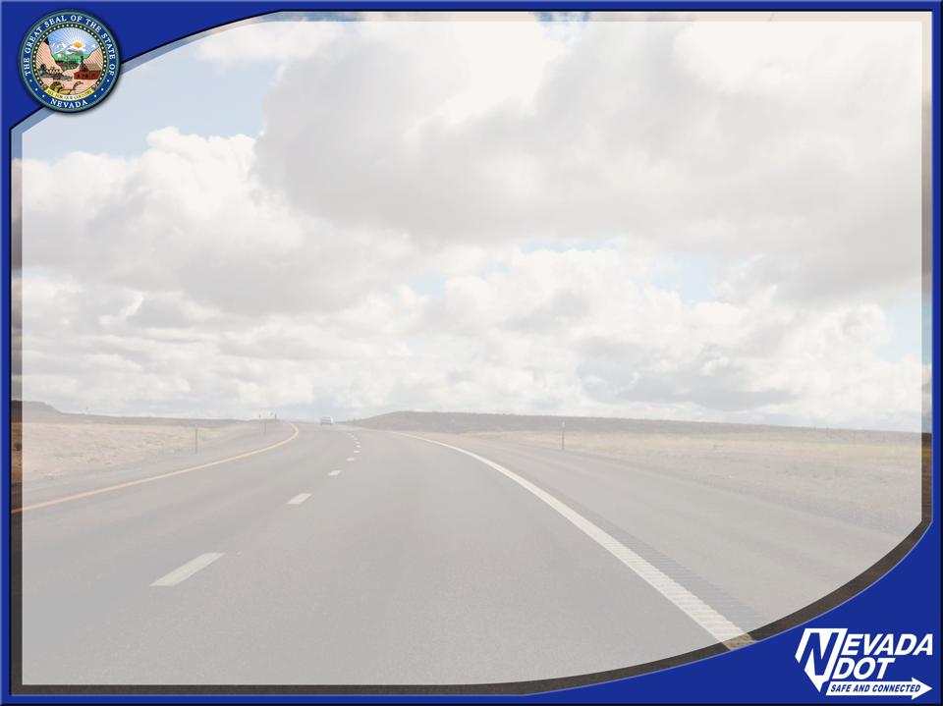
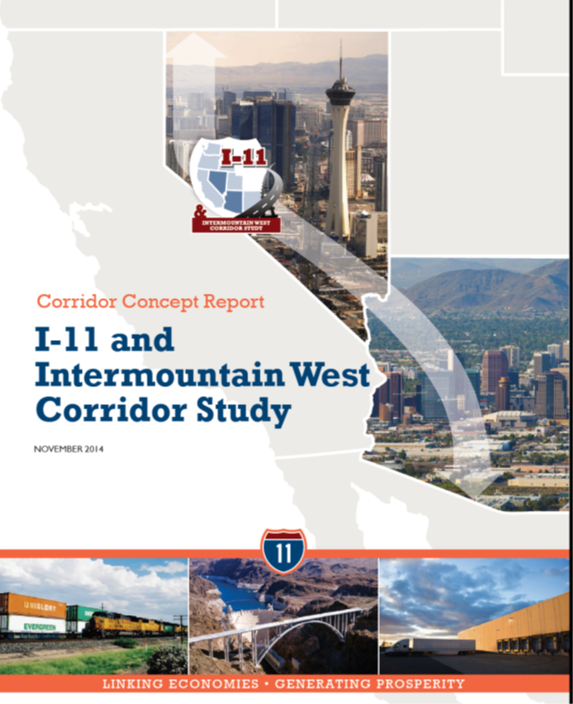
Overview
Study – completed November 2014, identified next steps for implementation
Corridor Actions underway and planned
Other opportunities
Notes:
The purpose of this presentation will be to provide an overview of the I-11 and Intermountain west Corridor Study,
Corridor Actions underway as well as Planned.
I will also provide a brief description on some of the other opportunities the Department is involved with regarding I-11

Slide 3
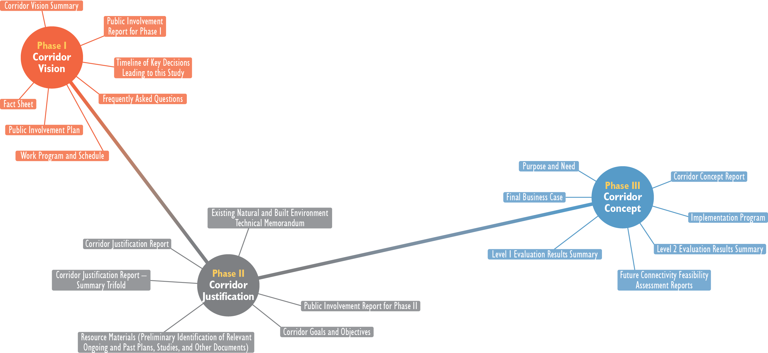
What Did this Study Entail?
Notes:
As you can see the I-11 Corridor Study has three parts
The Corridor vision - which included the Corridor Vision Summary, this stage of the study also laid out the Public Involvement plan.
The second phase was the Corridor Justification which provided the Corridor Justification Report and Corridor Goals and Objectives
The third phase of the plan was the Corridor Concept which developed the Purpose and Need as well as the Business Case.

Slide 4
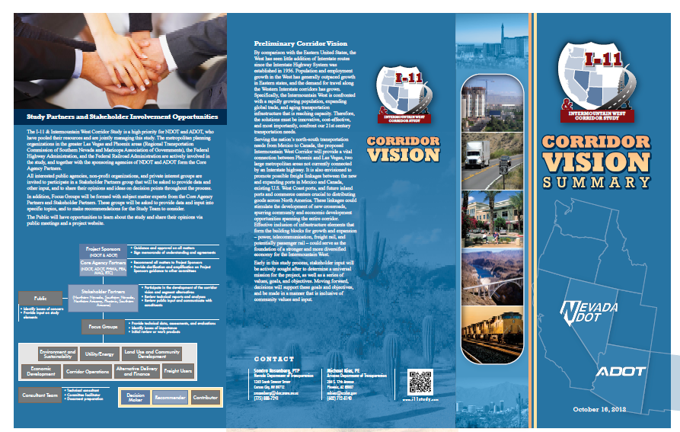
Corridor Vision
Potential benefits:
Connecting communities
Enhancing economic vitality of communities
Improving safety and travel time reliability
Providing relief for congested north-south corridors in the west
Enhancing commercial opportunities by linking trade
Increasing the global competitiveness of the region
Notes:
The Corridor Vision laid out the Potential Benefits which includes:
Connecting communities and Enhancing Economic Vitality of communities,
Improving safety and travel time reliability,
Providing relief for congested north-south corridors in the west
Enhancing commercial opportunities by linking trade
And Increasing the global competitiveness of the region

Slide 5
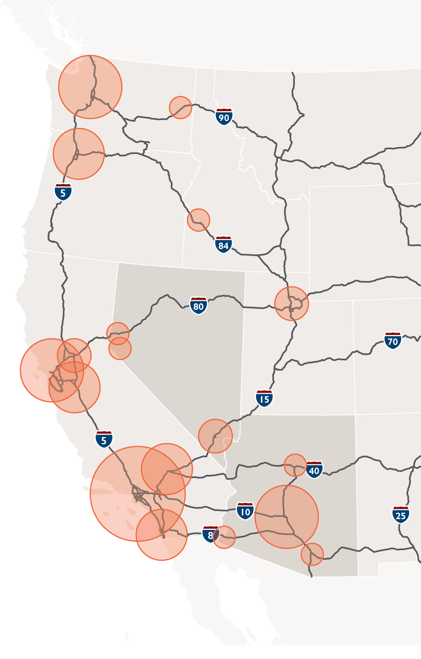

Corridor Justification
Integrate the economies of the Southwest Triangle megaregion
Capitalize on Mexico’s growing role in North American manufacturing/trade
Support economic development initiatives of Arizona and Nevada
Prevent congestion from crippling economic competitiveness
Notes:
The Corridor Justification demonstrated that the corridor would help
Integrate the economies of the Southwest Triangle megaregion
Capitalize on Mexico’s growing role in North American manufacturing and trade
Support economic development initiatives of both Arizona and Nevada
And also prevent congestion from crippling economic competitiveness

Slide 6
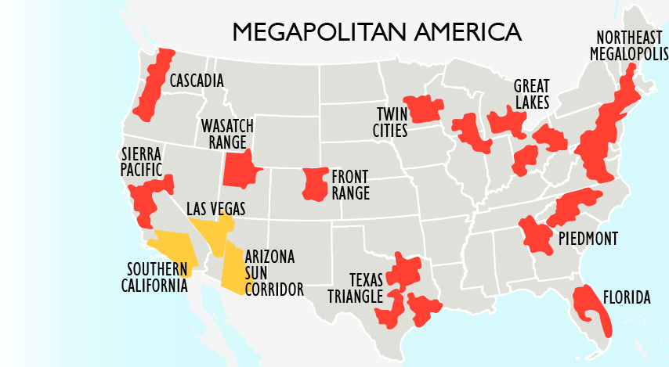


Business Case: Generating Prosperity
Asia
Latin America
Notes:
The Business Case demonstrates how the I-11 corridor can help link a number of regions.
The Southwest Triangle illustrated above is on a trajectory to be a leading American region that maintains linkages to the worlds fastest emerging economies in both Asia and Latin America; The I-11 corridor would only strengthen the economic growth and diversity of this megapolitan.
Side note a megapolitan is a conglomeration of two or more intertwined metropolitan areas with a combined population of 5 million or more, and is characterized by interlocking economic systems.

Slide 7
UPDATE
Both states
  Ensure consideration of findings is included in future & ongoing planning efforts (e.g. Statewide Long Range Plan, Freight Plan)
  Implementing incremental projects
  Extension language included in FAST Act: Nogales to I-80
Arizona
Continued work on US 93 – 4 lane divided hwy
Initiated a Tier 1 EIS for Wickenburg to Nogales
Continue working with Mexico to ensure connectivity
Notes:
Both states are still working on the implementation of the corridor plan and are ensuring that the findings are included in future and ongoing planning efforts.
NDOT has started developing a Long Range Plan called the One Nevada Plan which will include examining I-11 has a critical corridor.
Both states are implementing incremental projects within the corridor
I-11 language was included within the current transportation bill, FAST ACT
extending the I-11 designation from Nogales to I-80 (and within the 95 corridor).
Arizona is continuing work on the US93 portion to make this facility a 4 lane Divided hwy
they have started a Tier I EIS for Wickenburg to Nogales.

Slide 8
Nevada Update
Under Construction:
I-11 Boulder City Bypass
US 95 NW Phase 3A – Centennial Bowl
Planned
US 95 NW Phase 2B/5 – Durango to Kyle
US 95 - S.O. Tonopah – passing lanes, shoulder widening
US 95 – additional safety projects
Notes:
Currently NV is:
Completing the 1st segment of i-11 (Boulder City By-pass) this is a two phase effort with Southern Nevada RTC.
Some incremental improvements on 95 in and north of las Vegas include;
US 95 NW Phase 3a Centennial Bowl
US 95 NW Phase 2B/5 Durango to Kyle
NDOT will also will be looking at a scoping effort to see what improvements can be made within the corridor south of Tonopah

Slide 9
Partnering opportunities
Freight – Highway, Rail, …
Energy – Electric Highway
  Charging stations
  Energy Generation and Transmission
  Future “Solar Highway”
Communications
Emerging Technologies
  Autonomous/Connected vehicles
  Hyerloop or other potential transportation modes and technologies
Disclaimer: This list is not an endorsement or commitment of referenced initiatives or technologies, only a reference to potential future partnership opportunities in the development of the corridor.
Notes:
NDOT just completed a freight plan and within the plan incremental improvements were included within the list of projects
NDOT is also conducting a Southern Nevada Traffic Study which will include consideration of I-11 through Las Vegas. At the conclusion of this study, we will have a better idea of the future traffic demand on the freeway system in Southern NV and what role I-11 might Play.
Other partnering opportunities include NDOT’s involvement with the Governors office of Energy on the US 95 Electric Highway.
We have also partnered with the Governors office of Economic Development and Southern NV RTC on the HyperLoop One global Challenge to submit an application for a connection between Southern and Northwestern NV –

Slide 10
Nevada must plan to deliver our vision while remaining flexible to uncertainties in economic and technological drivers.
For more information on the corridor study and current I-11 activities: www.i11study.com
For more information on planned upcoming projects:
estip.nevadadot.com
Notes:
For more information on the corridor study and current I-11 activities please visit the site listed
Also you can visit Nevada’s State Transportation Improvement Program on line to get more information on planned upcoming projects at the list site.

Slide 11



