Slide 1
DATA IN A NUTSHELL
TRAVEL NEVADA
March 2024 TNT Partners Call, March 27, 2024

Slide 2
DATA. WHAT IS IT? WHY DO YOU NEED IT? HOW DO YOU GET IT?

Slide 3
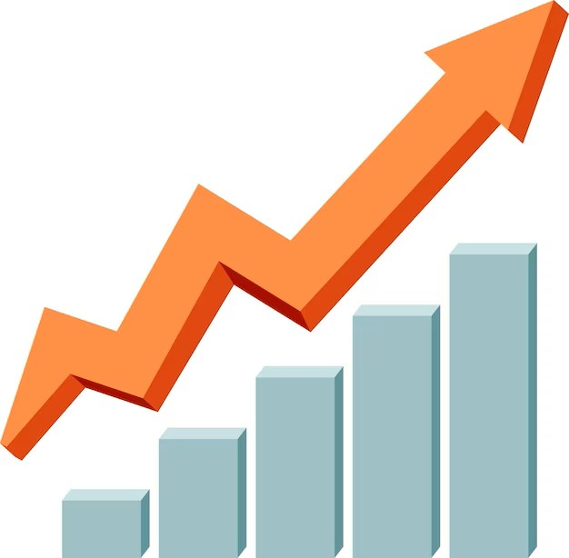
Why Use Data?
Improve services
Make informed decisions
Prove your worth to decision-makers and funders
Stop guessing
Measure outcomes and effectiveness
Be strategic
Be efficient
See trends over time
WHY USE DATA?

Slide 4
TYPES OF DATA – Qualitative
Describes qualities or characteristics.
Examples: Survey responses, opinion polls, demographic/ psychographic information.
Unstructured – “How do you feel about…”, “What would you do if...”
Categorical data with no meaningful order (gender, interests, point of origin) –OR- categorical data that can be ordered, but only show sequence, not value (customer satisfaction scales, preference rank).
TYPES OF DATA

Slide 5
DEMOGRAPHICS VS. PSYCHOGRAPHICS
Married, Age 40
Earns $80k/year
Female
Lives in Midsize City
Management job
Loves the outdoors
Values family time
Enjoys traveling
Has a pet
Likes to stay fit
TYPES OF DATA

Slide 6
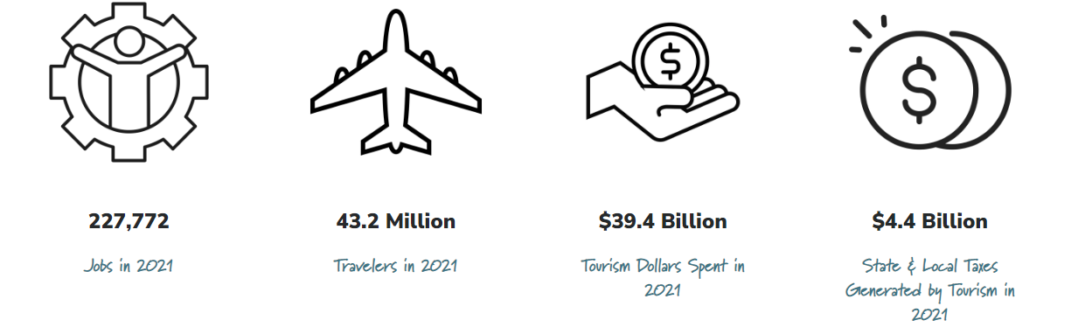
TYPES OF DATA – Quantitative
Can be counted, measured, or given a numerical value (how many, how much).
Examples: Number of attendees, amount of money spent, number of rooms occupied
TYPES OF DATA

Slide 7
PROCESS VS. OUTCOME
Process Evaluation can help you see how effective your organization was at executing a project.
Outcome Evaluation looks at the results of your project. Did you meet your deliverables? What was the impact? How did it turn out?
Who might be interested in process evaluation?
Why is it important to know what outcome measures you are going to collect?
What data might you collect to evaluate your process?
What are some outcome measures that might be important for you?
DATA COLLECTION

Slide 8
COLLECTING DATA? HAVE A PLAN.
What do you want to measure?
What data do you need?
How will you collect it?
How are you going to use the data?
Who are you going to share it with?
How long will you collect the data?
DATA COLLECTION

Slide 9
HOW TO COLLECT DATA
Surveys and Interviews
Focus Groups/ Community Sessions
Observation
Third-party Data (Data Companies)
Online Analytics (Website, Social Media)
Records and Documents
DATA COLLECTION

Slide 10
WHERE DID YOU GET THAT DATA?
Primary Data: Data you gathered yourself
Secondary Data: Data that someone shared with you
Third-party Data: Data that has been aggregated
DATA COLLECTION

Slide 11
WHAT DATA COLLECTION METHOD IS RIGHT FOR YOU?
What is your organizational Capacity?
How sophisticated is the data?
WHAT is your DATA budget?
WHO Has the information you need?
Do you need help interpreting the data?
WHAT TYPE OF DATA?
FANCY/ HIGH TECH IS NOT ALWAYS BETTER OR NECESSARY.
DATA COLLECTION

Slide 12
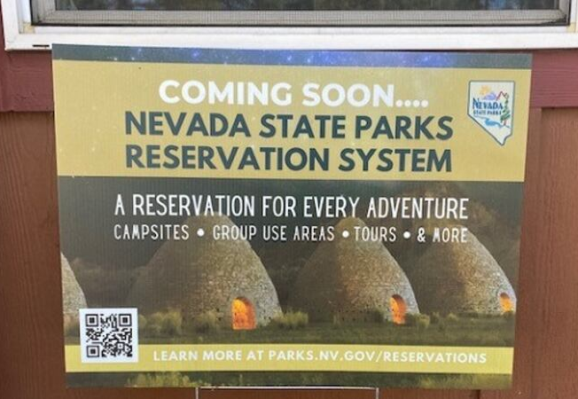
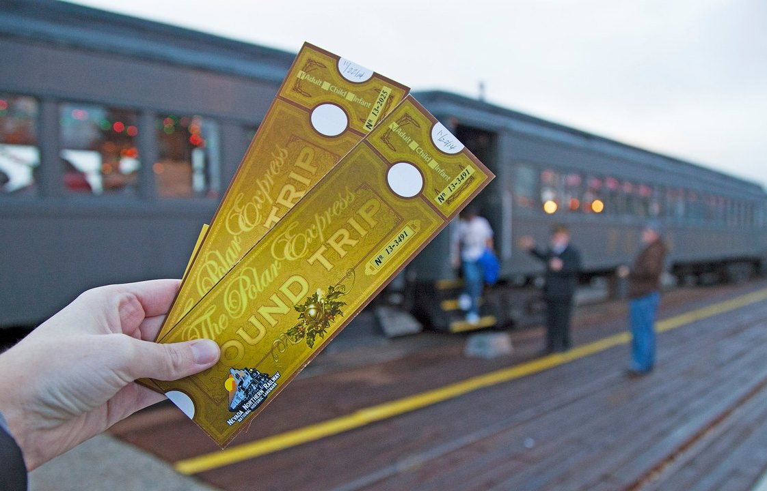
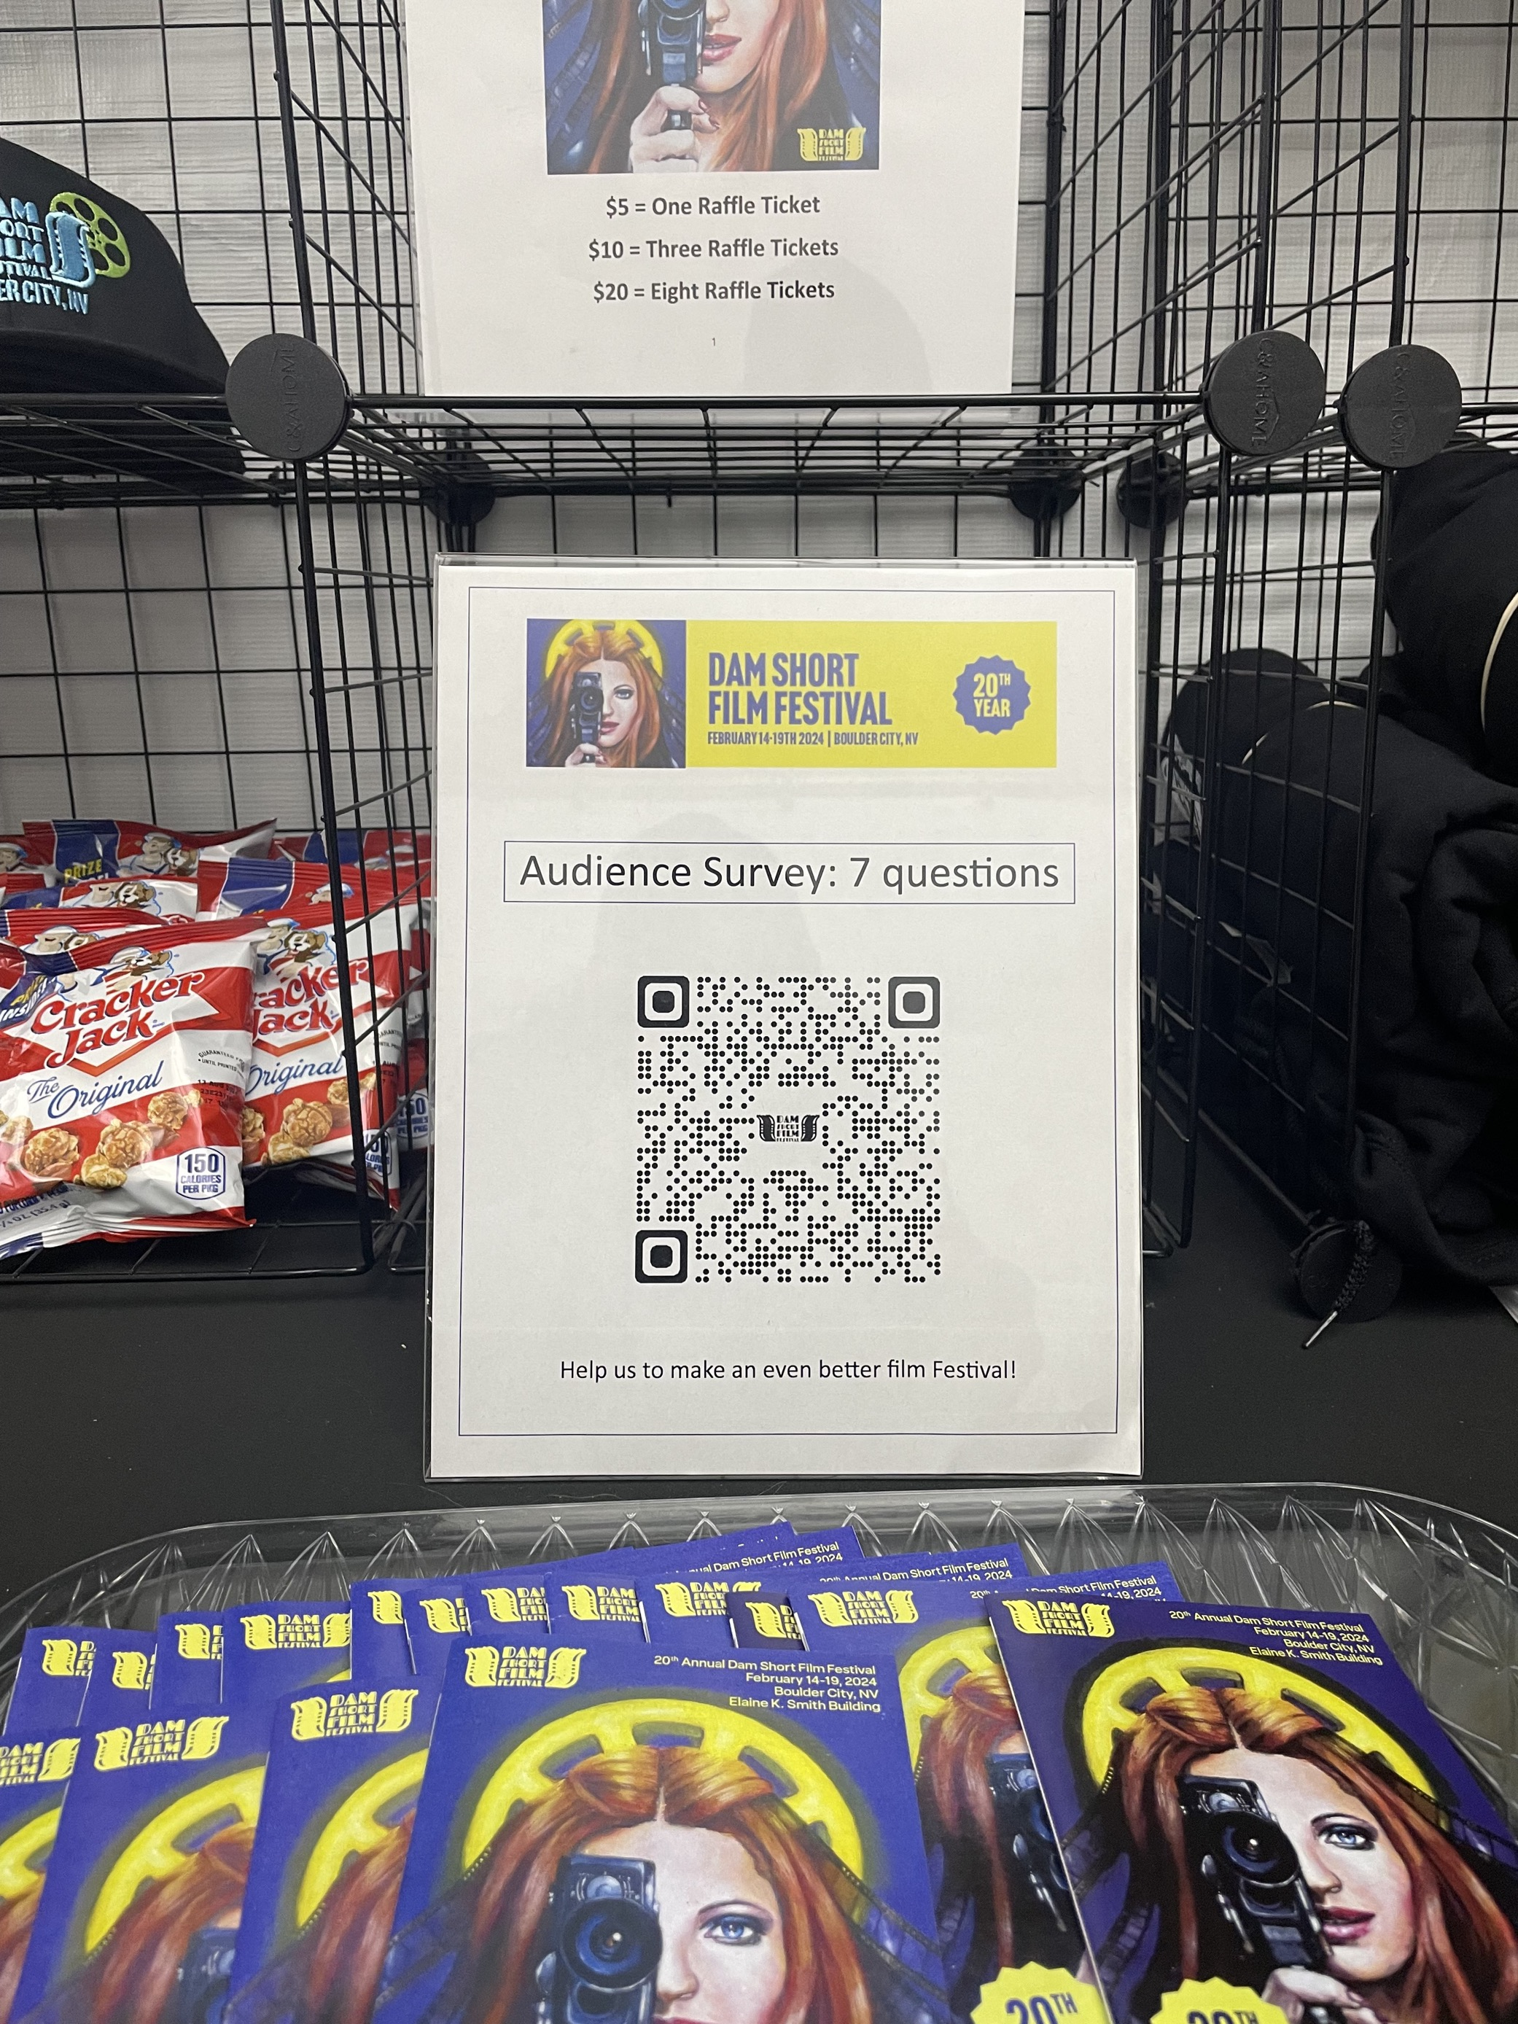
DATA COLLECTION DOESN’T HAVE TO BE HARD OR COMPLEX.
What are some simple but effective data collection methods you can think of?
DATA COLLECTION

Slide 13
COLLABORATING TO SHARE DATA
Example: Chamber of Commerce shares information on room tax collections to members after an event.
Do you have a local organization or workgroup to facilitate data-sharing?
Working together with other local businesses to share information and ideas is a good strategy.
What professional/industry organizations might have data that could be helpful?
What are some needs in your community that you can tackle together?
Data sharing can be a formal or informal process.
DATA COLLECTION

Slide 14
HOW TO APPLY DATA TO DECISION-MAKING
ADVOCACY
PROGRAM DEVELOPMENT
MARKETING/BRANDING
Tell policy-makers or constituents about the impact of work you’re doing
Illustrate your story and build understanding and support
Influence resource allocation or policy
Identify areas for improvement
Create synergies between programs
Uncover new program areas
Clarify needs
Gain feedback from team members and stakeholders
Uncover new target markets
Identify your existing and target audience(s)
Learn information about your target audience(s)
Evaluate campaign reach
Determine ROI
USING DATA

Slide 15
USING DATA TO MAKE YOUR CASE
GOAL:
Secure funding from a bank
For small businesses, getting financing or a loan requires data to back up your creditworthiness.
GOAL:
Win a grant award
Grantmakers want to see that you have a well-considered data plan to show effectiveness.
GOAL:
Gain policymaker support for your project
Policymakers want to be assured that your program is a good investment of public funds.
USING DATA

Slide 16
INTERPRETATION IS IMPORTANT
Understand what the data is telling you.
What is being shown?
How is it being measured? What units?
When was the data gathered? By whom?
Does it pass the “smell test”?
Is the data believable?
Is there bias?
Do you see any trends?
Ask for help if you need it.
USING DATA

Slide 17
Garbage in Garbage out
A word of caution…

Slide 18
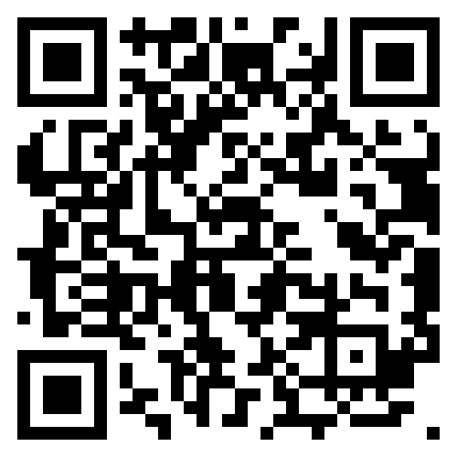
CHECK OUT TRAVEL NEVADA’S RESEARCH HERE
Notes:
The information is updated at various times throughout the year as it becomes available – generally Discover the Facts is quarterly, the Territory Profiles (updated around April / May) and the Economic Impact Report (updated around July / August) are annual, and the Tourism Ecosystem Report is every other year.

Slide 19
WANT TO LEARN MORE ABOUT TOURISM IN NEVADA? JOIN US APRIL 10-12 AT LAKE TAHOE FOR RURAL ROUNDUP! www.RuralRoundup.com

Slide 20
HOW TO STAY UP TO DATE WITH TRAVEL NEVADA
New Partners & Returning Partners Updates
Industry Newsletter
https://travelnevada.biz/industry-newsletter/
www.facebook.com/NVTourism
Request to join our industry group: www.facebook.com/groups/nevadatourismindustry
https://travelnevada.biz/resources/list-your-business/
NV Magazine & Visitor Guide:
Order Copies / Place an Ad
carrie@travelnevada.com
Share Ideas for Feature or Story
editor@travelnevada.com
KEEP IN TOUCH

